Slide 1
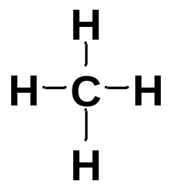
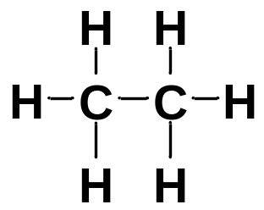
Chapter 2 Alkanes and Cycloalkanes
1. Introduction to alkanes
Hydrocarbons: compounds composed entirely of C and H atoms.
Alkanes are hydrocarbons that contain only single bonds.
Hydrocarbons
Alkanes
Alkenes
Alkynes
Aromatics
The general molecular formula for alkanes is C_{n}H_{2n+2}.
Alkanes are described as the class of saturated hydrocarbons because they have the maximum number of bonded hydrogens.
The alkanes are the simplest and least reactive class of organic compounds, without functional groups.
methane ethane

Slide 2
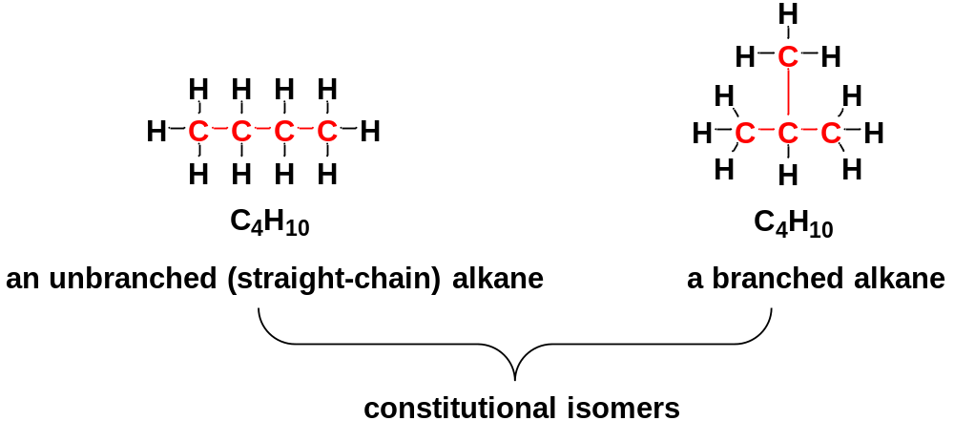
2. Constitutional Isomerism
Isomers: different compounds with the same molecular formula.
Constitutional isomers: isomers that differ in their bonding sequence, their atoms being connected differently.
The number of constitutional isomers increases rapidly as the number of carbon atoms increases.
Butane (C₄H₁₀) has 2 constitutional isomers.
Pentane (C₅H₁₂) has 3 constitutional isomers.
Hexane (C₆H₁₄) has 5 constitutional isomers.
Octane (C₈H₁₈) has18; Decane (C₁₀H₂₂) has 75.

Slide 3
3. Nomenclature
3-1 Common Names
Common names are historical names arising from common usage.
3-1-1 Unbranched Alkanes: n-Alkanes
Name | Number of Carbons | Structure | Formula
methane | 1 | H−CH₂−H | CH₄
ethane | 2 | H−(CH₂)₂−H | C₂H₆
propane | 3 | H−(CH₂)₃−H | C₃H₈
butane | 4 | H−(CH₂)₄−H | C₄H₁₀
pentane | 5 | H−(CH₂)₅−H | C₅H₁₂
hexane | 6 | H−(CH₂)₆−H | C₆H₁₄
heptane | 7 | H−(CH₂)₇−H | C₇H₁₆
octane | 8 | H−(CH₂)₈−H | C₈H₁₈
nonane | 9 | H−(CH₂)₉−H | C₉H₂₀
decane | 10 | H−(CH₂)₁₀−H | C₁₀H₂₂

Slide 4

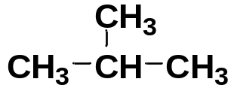

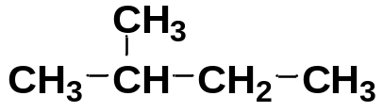
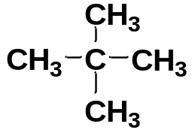
3-1-2 Branched Alkanes
Formula | Constitutional isomers | Common Name
C₄H₁₀ |  | n-butane
 |  | isobutane
C₅H₁₂ |  | n-pentane
 |  | isopentane
 |  | neopentane
Common names cannot easily describe many isomers. Therefore, we need a system of nomenclature that enables us to name complicated alkane molecules.

Slide 5
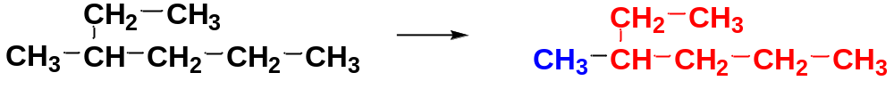
3-2 Systematic Names/IUPAC Names
IUPAC: International Union of Pure and Applied Chemistry.
A system for naming compounds that is simple to use and flexible enough to name even the most complicated organic compounds was devised by IUPAC.
The IUPAC names are based on the structures of the alkanes.
3-2-1 A simple example
the substituent:
the alkyl group
the main chain
the positions of the substituents + the names of the substituents + the base name

Slide 6
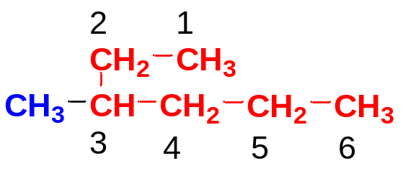
Steps to give IUPAC names (systematic names):
Step 1: Identify the main chain to give the base name and the names of substituents.
Choose the longest continuous chain of carbon atoms as the main chain, and use the name of this chain as the base name of the alkane; The remaining parts on the main chain are substituents;
methylhexane
Step 2: Number the Main Chain to give the locations of the substituents.
Begin with the end of the main chain nearest a substituent so that the number set of the substituted carbons will be as low as possible.
methylhexane → 3-methylhexane

Slide 7
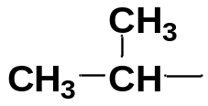
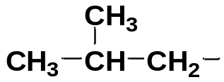
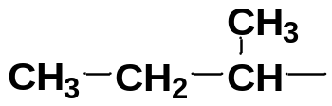
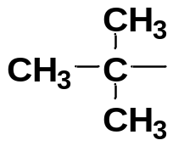
3-2-2 Common names of simple alkyl groups
Alkyl groups are named by replacing the –ane suffix of the alkane name with –yl.
CH₄ | methane | CH₃− | methyl group (Me)
CH₃CH₃ | ethane | CH₃CH₂− | ethyl group (Et)
CH₃CH₂CH₃ | propane | CH₃CH₂CH₂− | (n)-propyl group (Pr)
 |  |  | isopropyl group
 | butane | CH₃−CH₂−CH₂−CH₂− | n-butyl group (Bu)
 |  |  | isobutyl group
 |  |  | sec-butyl group
 |  |  | tert-butyl group

Slide 8
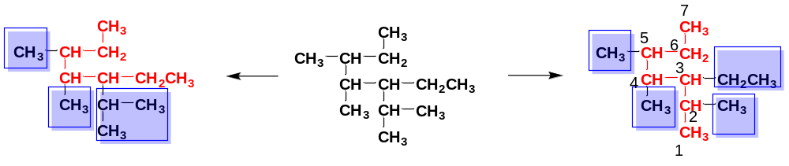
3-2-3 a complex example
When there are two longest chains of equal length, use the chain with the greater number of substituents as the main chain.
When two or more substituents are present, list them in alphabetical order.
When substituents are alphabetized, iso is used as part of the alkyl group name, but the hyphenated prefixes are not. Thus isobutyl is alphabetized with i, but n-butyl, t-butyl, and s-butyl are alphabetized with b.
When two or more of the same substituents are present, use the prefixes di-, tri-, tetra-, etc. to avoid having to name them repeatedly.
heptane → ethyltrimethylheptane → 3-ethyl-2,4,5-trimethylheptane

Slide 9
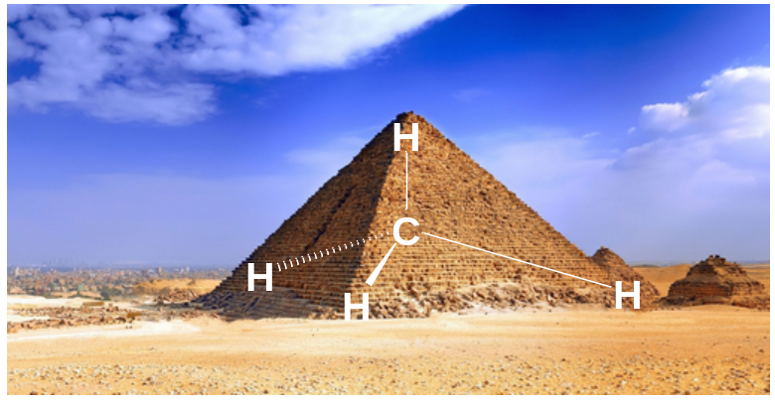
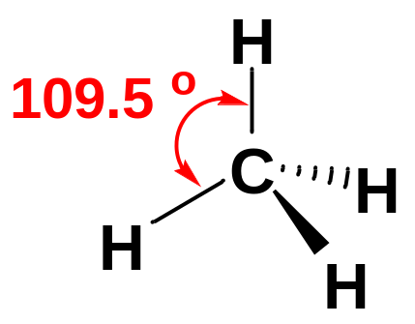
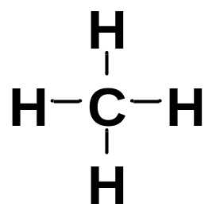
4. Structure and Conformations of Alkanes
4-1 Tetrahedral Carbon and the Hybridization Theory
the Lewis structure of methane
the real shape of methane as represented by the perspective drawing
Hybridization theory is a useful theoretical tool to explain the real shape of molecules:
① The shapes of many molecules are not the result of bonding between simple s and p atomic orbitals.
② Orbitals on the same atom may interact with each other to give hybrid atomic orbitals .
③ The number of hybrid atomic orbitals is the same as that of the initial participating orbitals.
④ Hybrid atomic orbitals are separated by the largest possible angles in space to avoid repulsion among electron pairs, thus defining the geometry of the bonds.

Slide 10
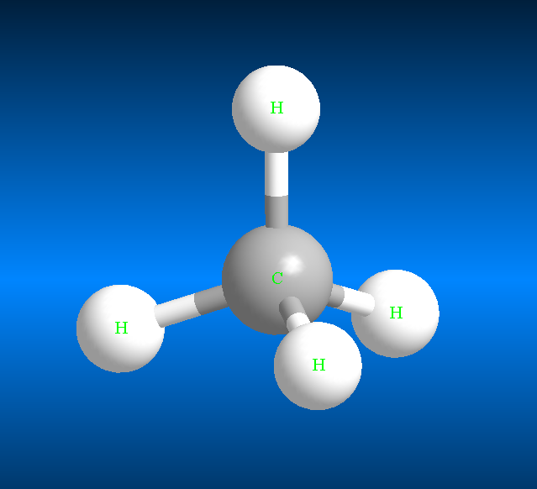
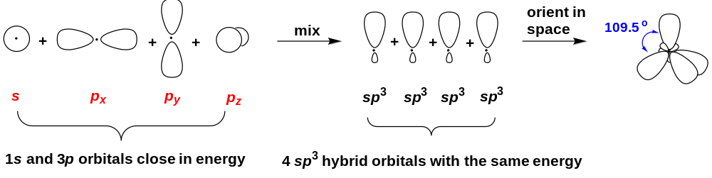
4-2 Tetrahedral Carbon and the sp³ hybridization
Element | Electronic configuration | Valence Electrons
H | 1s¹ | 1
C | 1s²2s²2p_{x}¹2p_{y}¹2p_{z}⁰ | 4
Before hybridization
After hybridization

Slide 11
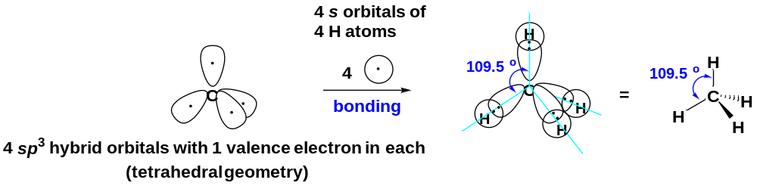
The C—H bonds in methane are s-sp³ overlap
The bonding has most of its electron density centered along the line connecting the nuclei. This type of bond is called a sigma bond (σ bond).
All single bonds in organic compounds are sigma bonds.

Slide 12
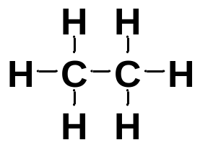
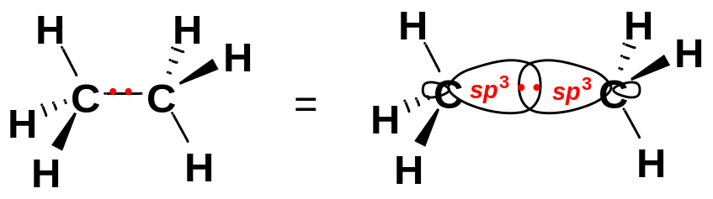
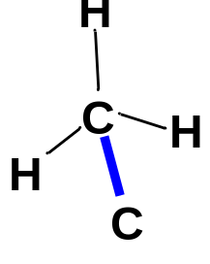
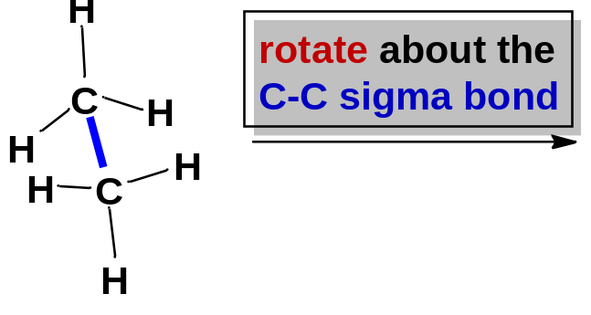
4-3 Ethane and its conformations
In ethane, both carbon atoms are sp³ hybridized and tetrahedral.
The C−C single bond (σ bond) is formed by overlapping the sp³ hybrid orbitals from each carbon.
C−H bonds: sp³-s overlap
C−C bond: sp³-sp³ overlap
Lewis structure perspective drawing
4-3-1 Conformations of ethane
Rotation about the C−C single bond results in infinite images of ethane, differing only in how one methyl group is twisted in relation to the other one.
Is the connectivity (bonding sequence) changed by rotating about the C-C single bond?
Are they constitutional isomers?
H
H
H
H
H
H
H
H
H
H
H
H
H
H
H
H
H
H
H
H
H
one image
other images
Conformations: the different molecular images formed by rotations about a single bond.

Slide 13
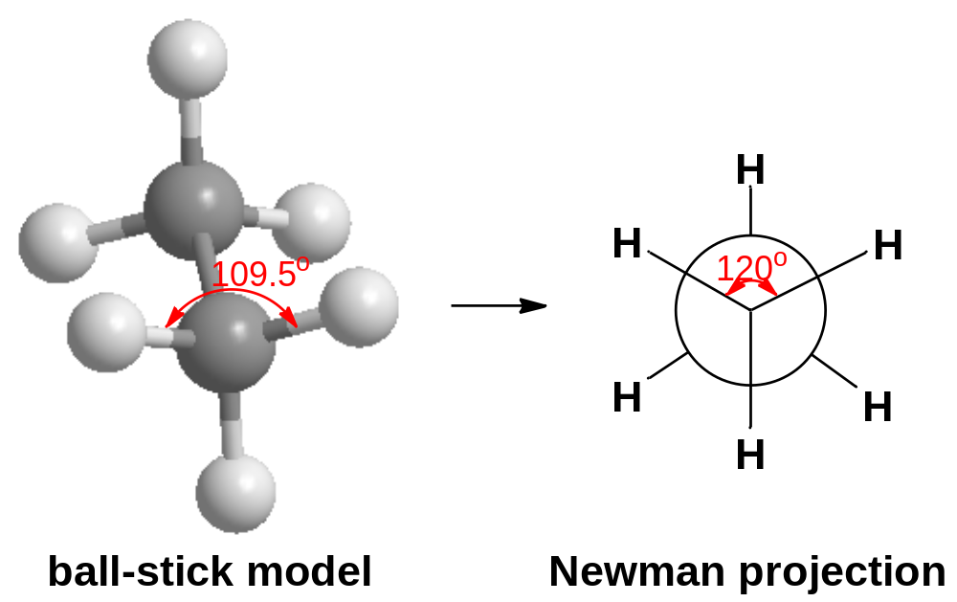
4-3-2 Expression of conformations: Newman Projections
In drawing conformations, we often use Newman projections, a way of drawing a molecule looking straight down the bond connecting two carbon atoms.
The front carbon is represented by three lines (three bonds) coming together in a Y shape; the back carbon is represented by a circle with three bonds pointing out from it.
look straight down the C−C bond

Slide 14
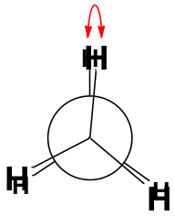
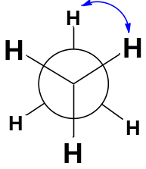
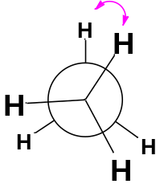
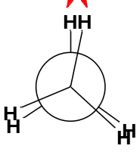
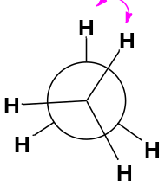
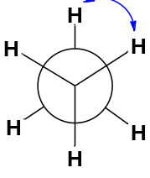
4-3-3 The typical conformations of ethane
Ethane has an infinite number of conformations.
Any conformation can be specified by its dihedral angle (θ), the angle between the front C−H bond and the back C−H bond in the Newman projection.
Two of the conformations are typical and have special names:
θ = 0°
θ = 60°
θ
the eclipsed conformation
the staggered conformation
a skew conformation
At room temperature, the ethane molecules are rotating and their conformations are constantly changing. Normally conformations cannot be isolated.
θ
room
temperature
room
temperature
the eclipsed conformation
skew conformations
the staggered conformation

Slide 15
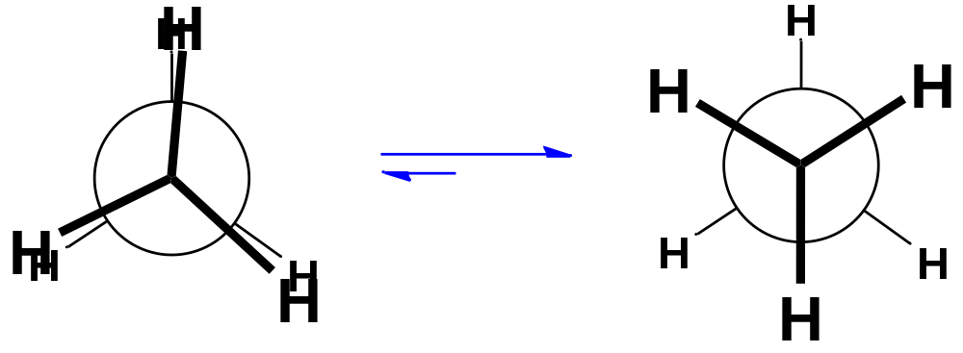
4-3-4 The relative stability of conformations
The conformations are not all equally favored: the lowest-energy conformation is the staggered conformation; the highest-energy conformation is the eclipsed conformation.
the C-H bonding electrons are close, repulsive.
the C-H bonding electrons are separated as much as possible.
the eclipsed conformation
(high energy, disfavored)
the staggered conformation
(low energy, favored)
The resistance to twisting (torsion) from the staggered conformation to other unstable ones is called torsional strain.

Slide 16
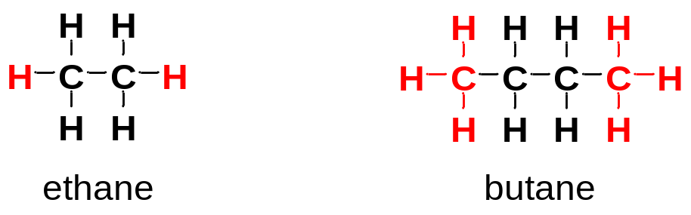
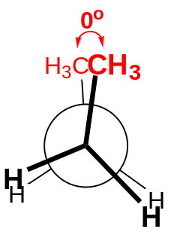
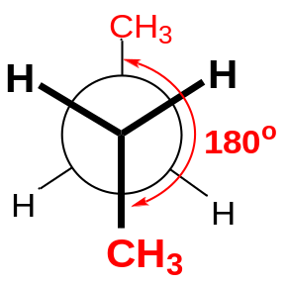
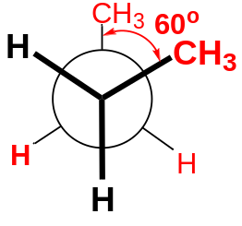
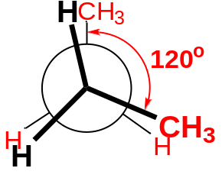
4-4 Conformational analysis of butane
Butane can be viewed as dimethyl-substituted ethane.
There are three C-C single bonds in butane. Rotations about any of the carbon-carbon bonds are possible.
Consider the conformations produced by rotating along the central C2-C3 bond.
Butane | totally eclipsed | gauche | eclipsed | anti
The totally eclipsed conformation has both torsional strain and steric strain (steric hindrance): great interference between two bulky methyl groups.
The gauche conformation does not have torsional strain, but has some repulsion between the two bulky methyl groups.
The eclipsed conformation has both torsional strain and some repulsion between the methyl and H.
The anti conformation has neither torsional strain nor steric hindrance.
Relative stability: anti > gauche > eclipsed > totally eclipsed.

Slide 17
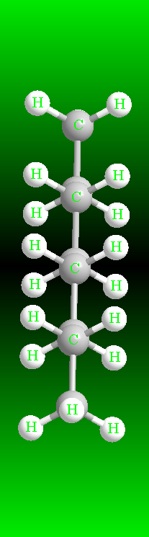
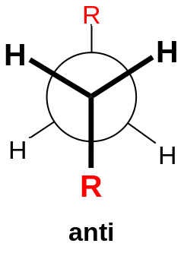
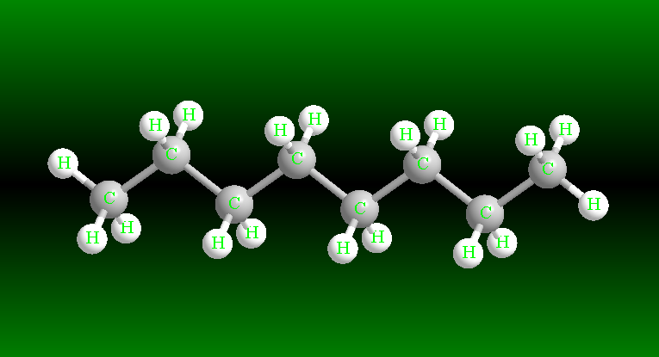
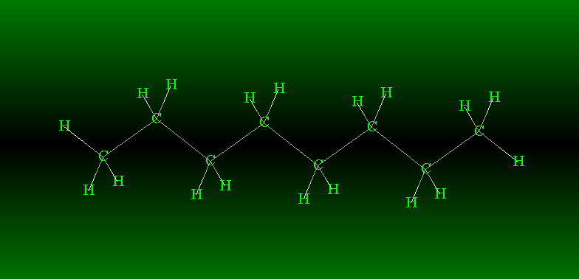
4-5 Conformations of Higher Alkanes
The higher alkanes resemble butane in their preference for anti (and gauche conformations) about the C-C bonds.
The lowest-energy conformation for any straight-chain alkane is the one with all the internal C-C bonds in its anti conformations.
These anti conformations give the chain a zigzag shape.
octane, all anti conformation
octane, all anti conformation
ball-stick model wire frame model
all anti

Slide 18
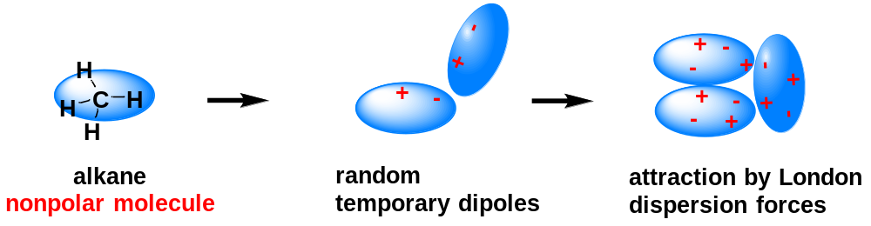
5. Intermolecular attractions of alkanes
5-1 Bond Polarity and Molecular Polarity
The polarity of an entire molecule is the result of the polarity of bonds associated with molecular geometry.
The C−C bonds and C−H bonds in alkanes are nonpolar bonds. The alkane molecules as a whole are nonpolar molecules.
5-2 Nonpolar molecules and London dispersion force
When two molecules approach, the forces are attractive until the molecules come so close that they infringe on each other’s atomic radius.
The nature of the attractions between molecules affects the physical properties (boiling points, melting points, densities, solubilities etc.) of organic compounds.
In nonpolar molecules, the principal attractive force is the London dispersion force.
The London dispersion force arises from temporary dipole moments.
A small temporary dipole moment is induced when one molecule approaches another molecule in which the electrons are slightly displaced from a symmetrical arrangement.
The London dispersion force depends on close surface contact of two molecules and therefore is roughly proportional to the molecular surface.

Slide 19
6. Physical Properties of Alkanes
The nature of the attractions between molecules affects the physical properties (boiling points, melting points, densities, solubilities etc.) of organic compounds.
Solubilities | Alkanes are nonpolar organic compounds: Dissolve in nonpolar or weakly polar organic solvents, but do not dissolve in water. – “like dissolves like”. Alkanes are said to be hydrophobic (water hating).
Densities | Around 0.7 g/mL, less dense than water.
Boiling Points | B.p. increase smoothly with increasing numbers of carbon atoms and increasing molecular weights.

Slide 20
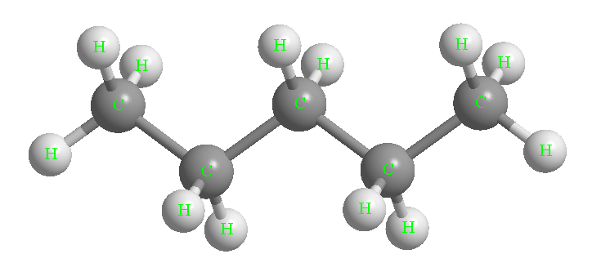
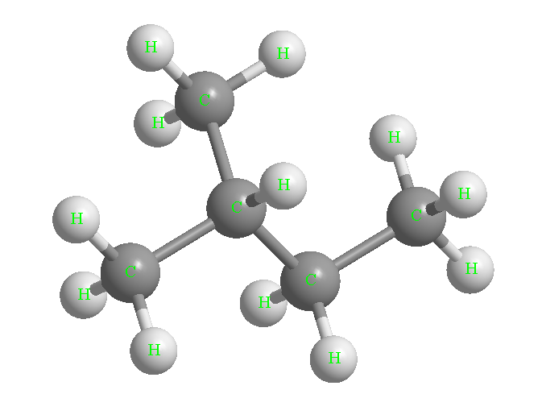
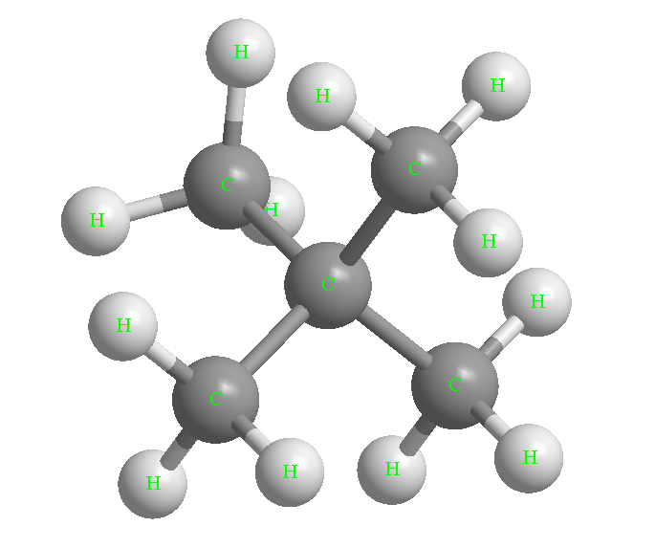
Larger molecules have larger surface areas, resulting in increased London dispersion.
These increased attractions must be overcome for vaporization and boiling to occur.
Thus, a larger alkane, with greater surface area and greater London dispersion forces, boils at a higher temperature.
Alkane | Formula | B.p./°C
butane | C₄H₁₀ | 0
pentane | C₅H₁₂ | 36
hexane | C₆H₁₄ | 69
heptane | C₇H₁₆ | 98
A branched alkane boils at lower temperature than the n-alkane with the same number of carbon atoms.
This difference in boiling points arises because branched alkanes are more compact, with less surface area for London force interactions.
Alkane | n-pentane | isopentane | neopentane
B.p./°C | 36 | 28 | 10

Slide 21
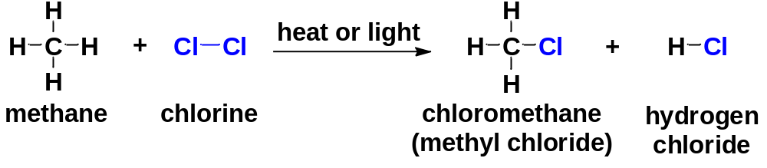
7. Halogenation of Alkanes: the Free Radical Substitution Reaction
Halogenation: The reaction of alkanes with halogens (F₂, Cl₂, Br₂, I₂) to form alkyl halides.
7-1 Chlorination of Methane
Either light or heat is needed for the halogenation reaction to take place at a useful rate.
The reaction of methane with chlorine produces a mixture of chlorinated products, whose composition depends on the amount of chlorine added.
It is called substitution reaction because chlorine atoms substitute for the hydrogen atoms.
When chlorine is added to methane, the first reaction is:

Slide 22
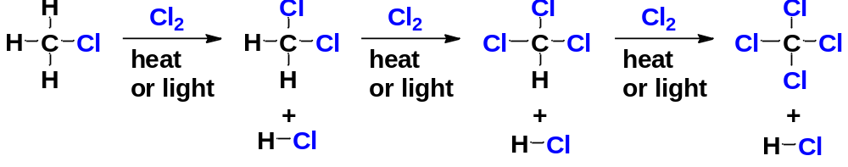
This reaction may continue; heat or light is needed for each step:
Study the overall reaction is only the first step in our study of a reaction. If we truly want to understand a reaction, we must know the mechanism of the reaction.
The mechanism is the complete, step-by-step description of exactly which bonds break and which bonds form in what order to give the observed products.
We will use the chlorination of methane to show how we study a reaction.

Slide 23
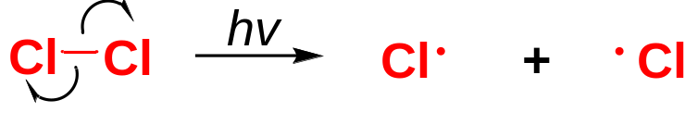
7-2 The mechanism of free radical substitution reaction
A chain reaction mechanism has been proposed to explain the chlorination of methane, consisting of 3 stages: ① The initiation step; ② Propagation steps; ③ Termination steps.
7-2-1 The Initiation Step: Generation of Radicals
We use the curved half-arrows to represent the movement of single electrons. Here the two electrons in the Cl−Cl bond separate, and one leaves with each chlorine atom;
Each Cl⋅ atom has an unpaired valence electron;
Species with unpaired electrons are called (free) radicals.
Radicals are electron-deficient because they lack an octet. They are highly reactive. The single electron of a radical readily combines with an electron in another atom to complete an octet and form a bond.

Slide 24
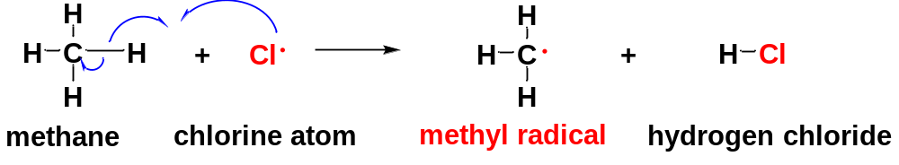
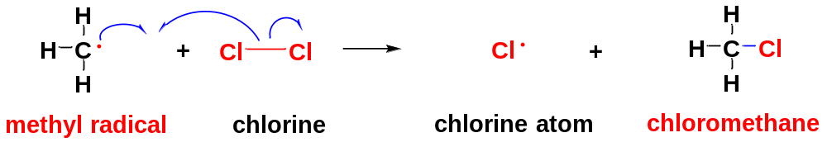
7-2-2 Propagation Steps
In the propagation steps, the free radical reacts with a stable molecule to form another free radical, allowing the chain to continue until the supply of reactants is exhausted or the free radical is destroyed.
For chlorination of methane, there are two propagation steps:
(1) Propagation step 1
Product 1
(2) Propagation step 2
Product 2
In this way, the chain reaction continues until the supply of the reactants is exhausted or some other reaction consumes the radical intermediates.

Slide 25
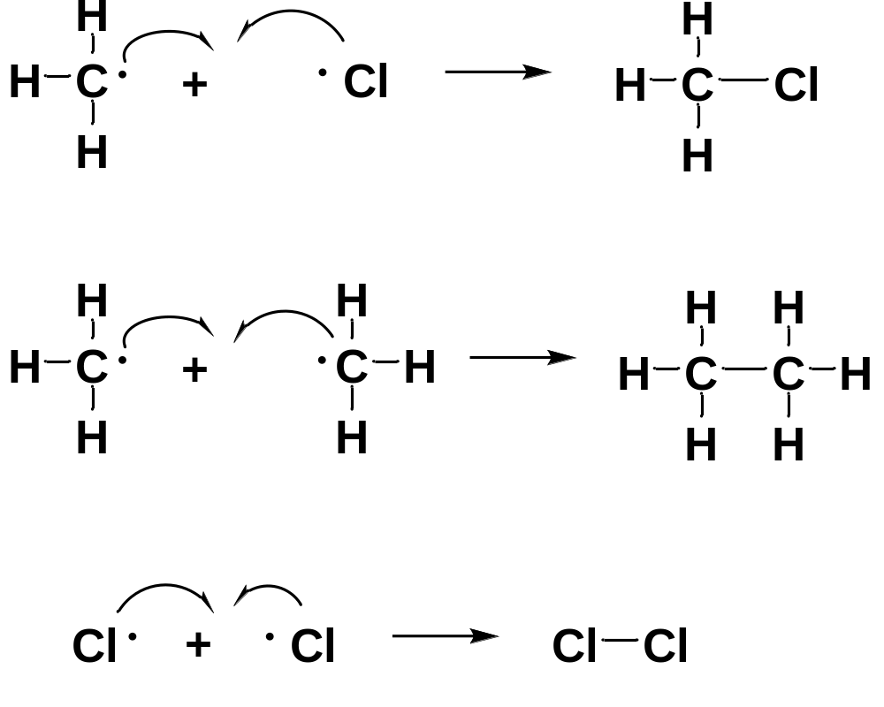
7-2-3 Termination Steps
In termination steps, one of the free-radical intermediates are consumed without generating new ones, thus slowing or stopping the chain reaction.

Slide 26

8. Introduction to cycloalkanes
The cycloalkanes are a special class of alkanes that are in the form of a ring.
Simple cycloalkanes are rings of CH₂ groups.
General molecular formula of cycloalkanes: C_{n}H_{2n}
The cycloalkanes are nonpolar, relatively inert compounds, resembling the acyclic, open-chain alkanes. Their physical properties are similar to those of the compact, linear alkanes.

Slide 27



9. Nomenclature of Cycloalkanes
Simple cycloalkanes are named like acyclic alkanes, with the prefix cyclo- indicating the presence of a ring.
Substituted cycloalkanes: use the cycloalkane for the base name, with the alkyl groups named as substituents.
No numbering is needed if there is just one substituent.

Slide 28



If there are two or more substituents on the ring, the ring carbons are numbered to give the lowest possible numbers for the substituted carbons. In a name, the substituents are listed in alphabetical order.
When the numbering could begin with either of two alkyl groups (as in a disubstituted cycloalkane), begin with the one that is alphabetically first.

Slide 29

10. Polycyclic rings
Two or more rings can be joined into bicyclic or polycyclic systems.
There are three ways that two rings may be joined.
Fused rings are most common, sharing two adjacent carbons and the bond between them.
Bridged rings are also common, sharing two nonadjacent carbon atoms (the bridgehead carbons) and one or more carbon atoms (the bridge) between them.
Spirocyclic compounds are relatively rare, with the two rings sharing only one carbon atom.

Slide 30


11. cis-trans Isomerism in Cycloalkanes
Open-chain alkanes undergo rotations about their C−C single bonds, so they are free to assume any of an infinite number of conformations.
However, the C−C single bonds in a cycloalkane can not undergo free rotations because of the rigid ring structure. This gives rise to cis and trans isomers with different orientations of the groups on the ring.
cis isomer: two substituents on the same side of a ring.
trans isomer: two substituents on opposite sides of the ring.
cis-trans isomers cannot interconvert without breaking and reforming bonds. They are different compounds;
cis-trans isomers have the same connectivity (bonding sequence). They are not constitutional isomers.
cis-trans isomers have the same bonding sequence, but they differ in the orientation of their atoms in space, we call them stereoisomers.

Slide 31



12. The instability of small rings: Angle Strain
12-1 the Angle Strain of Cyclopropane
The carbon atoms in acyclic alkanes have bond angles of 109.5°, explained by the tetrahedral geometry of the sp³ hybridized carbon atoms.
Small rings such as cyclopropane and cyclobutane require bond angles other than 109.5°, the orbitals of their C−C bonds cannot achieve optimum overlap, resulting in great angle strain and instability.
The C−C sp³ orbitals of cyclopropane cannot point directly toward each other, and they overlap at an angle to form weaker “bent bonds”.

Slide 32





There are large amounts of angle strain in small rings, especially in cyclopropane.
The existence of the significant angle strain results in instability of small rings.
Cyclopropane is generally more reactive than other alkanes.
Cyclobutane is less reactive than cyclopropane, but more reactive than cycloalkanes of large sizes and other alkanes.
12-2 Classifications of Rings
Small rings |  | Unstable, reactive
Common rings |  | Stable, commonly seen
Medium and Large rings |  | Less stable than common rings

Slide 33

13. the favored conformation of cyclopentane
If cyclopentane had the shape of a planar, regular pentagon, its bond angles would be 108°, close to the tetrahedral angle of 109.5°. However, a planar structure would require all the bonds to be eclipsed, resulting in great torsional strain.
Cyclopentane actually assumes a slightly puckered “envelope” conformation that reduces the eclipsing and lowers the torsional strain.

Slide 34



14. Cyclohexane Conformations
14-1 Chair conformation
Cyclohexane ring systems are particularly stable, common and abundant in nature.
The cyclohexane ring is not planar. The most stable conformation is the chair conformation, in which there are neither angle strain nor torsional strain.
In the chair conformation, the angles between the carbon-carbon bonds are all 109º: no angle strain.
The Newman projection shows all the bonds in staggered conformations: no torsional strain.

Slide 35

14-2 Axial and Equatorial Positions in the Chair Conformation
There are two different kinds of C−H bonds in the “frozen” chair conformation of cyclohexane: axial bonds and equatorial bonds.
Axial bonds: six of the bonds directed up and down, parallel to the axis of the ring.
Equatorial bonds: six of the bonds pointing out from the ring, along the “equator” of the ring.
Each carbon atom in cyclohexane is bonded to an axial hydrogen and an equatorial hydrogen.
C2, C4, C6 have axial bonds up and equatorial bonds down; C1, C3, C5 have equatorial bonds up and axial bonds down.
This pattern of alternating axial and equatorial bonds is helpful for predicting the conformations of substituted cyclohexanes.
axial hydrogens
equatorial hydrogens

Slide 36


14-3 Interconversion of chair conformations through ring flip
By rotation along the C-C bonds, one chair conformation can be converted to the other chair conformation through other typical but less stable conformations.
At any instant, most of the molecules in a cyclohexane sample are in chair conformations.

Slide 37

14-4 Conformations of Monosubstituted Cyclohexanes
A substituent on a cyclohexane ring (in the chair conformation) can occupy either an axial or an equatorial position.
The two possible chair conformations for methylcyclohexane are in equilibrium because they interconvert at room temperature.
The chair with the methyl group in an equatorial position is lower in energy and therefore is the predominant conformation.
equatorial CH₃
favored
The chair-chair interconversion changes equatorial to axial and axial to equatorial.

Slide 38



The axial methylcyclohexane conformation has gauche interactions: disfavored.
The axial methyl is placed too close to the two axial Hs on C3 and C5: repulsion; the axial methylcyclohexane conformation has a 1,3-diaxial interaction: disfavored.
A bulky substituent tends to adopt the equatorial position in the chair conformation of a cyclohexane.

Slide 39


14-5 Conformations of Disubstituted Cyclohexanes
The diaxial chair conformation is disfavored because of severe 1,3-diaxial repulsions.
The most stable conformation of the cis-isomer has both methyl groups in equatorial positions.

Slide 40

Either conformation of the trans-isomer places one methyl group in an axial position and one in an equatorial position.
For 1,3-dimethylcyclohexane, the trans-isomer is therefore higher in energy than the cis-isomer.
Remember that the cis and trans isomers cannot interconvert. They are different compounds, instead of different conformations of the same compound.
Consider the most stable conformations of 1,2-dimethylcyclohexane, and 1,4-dimethylcyclohexane.

Slide 41


In many substituted cyclohexanes, the substituents have different sizes. If both groups cannot be equatorial, the most stable conformation has the larger group equatorial and the smaller group axial.
Consider the most stable conformation of
tert-Butyl group is very bulky.
Cyclohexanes with t-butyl substituents are most stable when the t-butyl group is in an equatorial position.

Slide 42


15. cis- and trans-Decalin
Decalin is the most common example of a fused-ring system.
Decalin has two cis, trans-isomers: cis-decalin and trans-decalin
Which is lower in energy?

